Slide 1
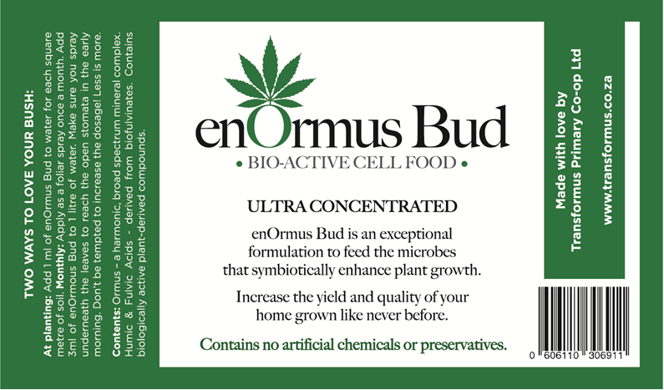
3
2
Contents: Ormus – a harmonic, broad spectrum complex. Fulvic acids derived from biofulvinates. Contains biologically active plant derived compounds.
1
Increase the yield of your home grown
like never before!

Slide 2
Font is Glosa Headline Black or Granada Serial bold
1
2
TWO WAYS TO LOVE YOUR PLANTS:
At planting: Add 1 ml of enOrmus Bud in water for each square metre of soil.
Monthly: Apply as a foliar spray once a month.
Add 3ml of enOrmus Bud to 1 litre of water.
Make sure you spray underneath the leaves to reach the open stomata
in the early morning.
Don’t be tempted to increase the dosage! Less is more.
Contents:
Ormus – a harmonic, broad spectrum mineral complex.
Fulvic acids derived from bio-fulvinates (10%). Mg 2.8%.
Biologically active plant derived compounds.
ULTRA CONCENTRATED
enOrmus Bud is an exceptional formulation to feed the microbes that symbiotically enhance plant growth.
Increase the yield of your home grown like never before!
Contains no artificial chemicals or preservatives.
3
100ml
Fertilizer Group 3 Reg. no. M166 Act 36 of 1947
Produced by Transformus Primary Co-Operative Ltd
Registration holder: enOrmus CC Reg 1992/00676/23
1 Bokkemanskloof Rd, Hout Bay. 7806

